Slide 1


IMAGE Caption Generation
Team Pixel(Team 8)
Purvang Jayesh Thakkar
Pratiksha Milind Lavhathre
Rashika Moza

Slide 2
INTRODUCTION AND PROBLEM DESCRIPTION
Without the deep learning and AI algorithms, this problem was very different to solve even for computer scientists because normal computers cannot understand the images as humans do. With the aid of Deep learning, we can solve this problem easily.
Image Caption Generation involves predicting a sequence of words(sentence) from an input image. It is essentially an advanced image classification problem with a lot of potential applications like:
• Aiding visually impaired people who rely on sounds and texts to describe a scene
• Targeted marketing on social media applications like Facebook and Instagram

Slide 3
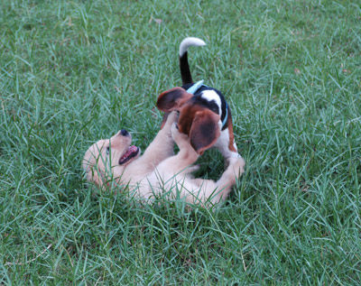
OBJECTIVE
Goal is to generate a descriptive sentence of an image
Potential Applications:
Aiding visually impaired
Generating video summary using individual frames
Neural
Network
Two dogs are wrestling in the grass

Slide 4
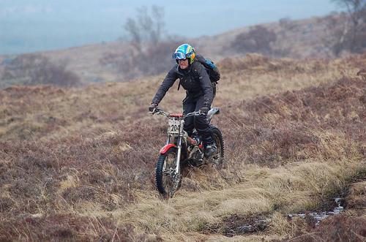
DATASET
We used Flickr8K dataset for this project
Flickr8K dataset contains a variety of images depicting scenes and situations
The dataset consists of 8000 images and each image has 5 corresponding descriptions
We split the data into 6000, 1000, & 1000 images as training, validation and testing sets respectively
The images are of different dimensions
A man riding his bike on a hill
A man with helmet and backpack standing on dirt bike in a hilly grassy area
A person rides a motorbike through a grassy field
Man on motorcycle riding in dry field wearing a helmet and backpack
The biker is riding through a grassy plain .

Slide 5
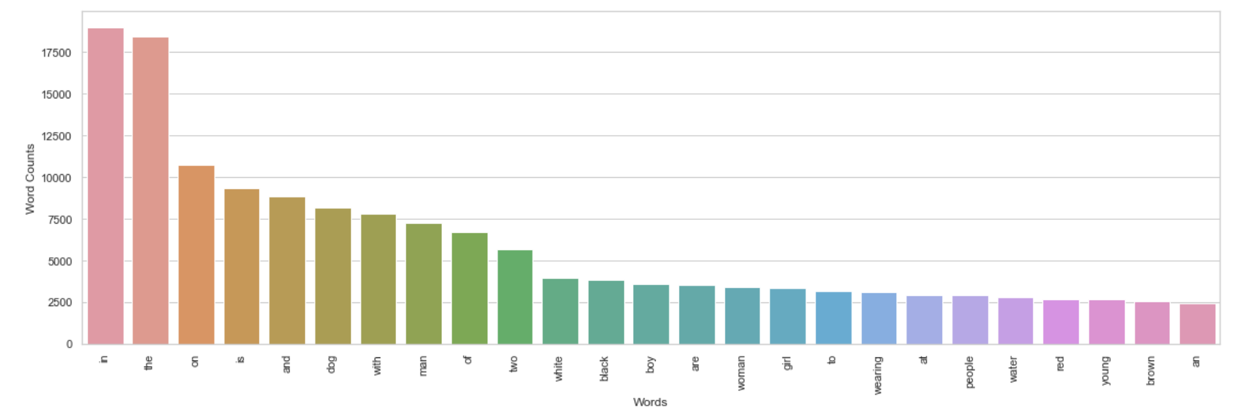
TEXT PRE-PROCESSING
Each description is tokenized and converted to lowercase
Removed alpha-numeric characters and punctuation marks
We use startseq and endseq as prefix and postfix for each caption respectively
Filtered out unique words from the corpus and represented each word by an integer
To generate a fixed length word vector we calculated the maximum length caption
Frequency of Words in Captions

Slide 6
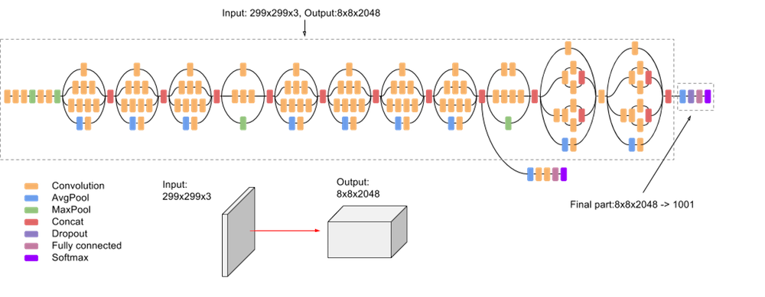
IMAGE FEATURE EXTRACTION
Resized all images to a fixed size of 299x299x3 using OpenCV
Employed transfer learning using pre-trained InceptionV3 CNN model to encode images
We removed the last softmax layer from the InceptionV3 network to extract 2048 image vector

Slide 7
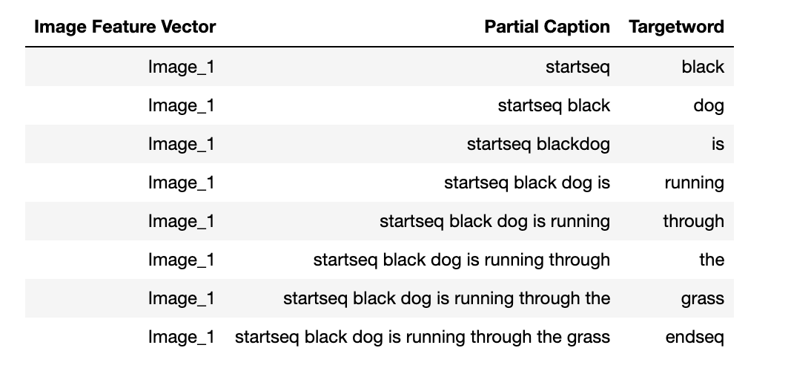
SEQUENTIAL CAPTION INJECTION
For each image we will train the model by temporally injecting incremental sequences of the description
In this phase, we essentially create labels in our training data

Slide 8
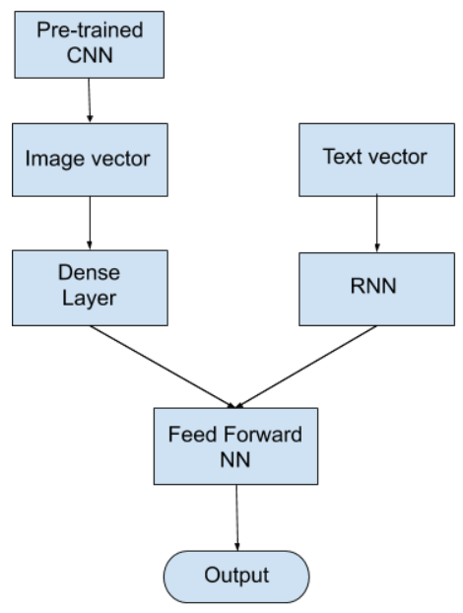
ARCHITECTURE
We used an encoder-decoder architecture
2048 image vector is fed to a Dense layer to generate 256 length image vector
34 length word vector is fed to LSTM/RNN to output 256 length word vector
Decoder model adds both the encoder outputs and is fed to Dense 256 layer
The last Dense layer will have as many nodes as the vocabulary size

Slide 9
GENERATING PREDICTIONS
Caption is predicted word by word
Image is fed along with the first word(startseq) to the RNN to predict the second word
Again, the same image along with first word + second word is fed to the RNN to predict the third word and so on until the last word(endseq) is encountered
Neural Network
model
Target Word
(i=0) little
(i=1) boy
(i=2) ….
(i=0) startseq
(i=1) startseq little
(i=2) …..

Slide 10
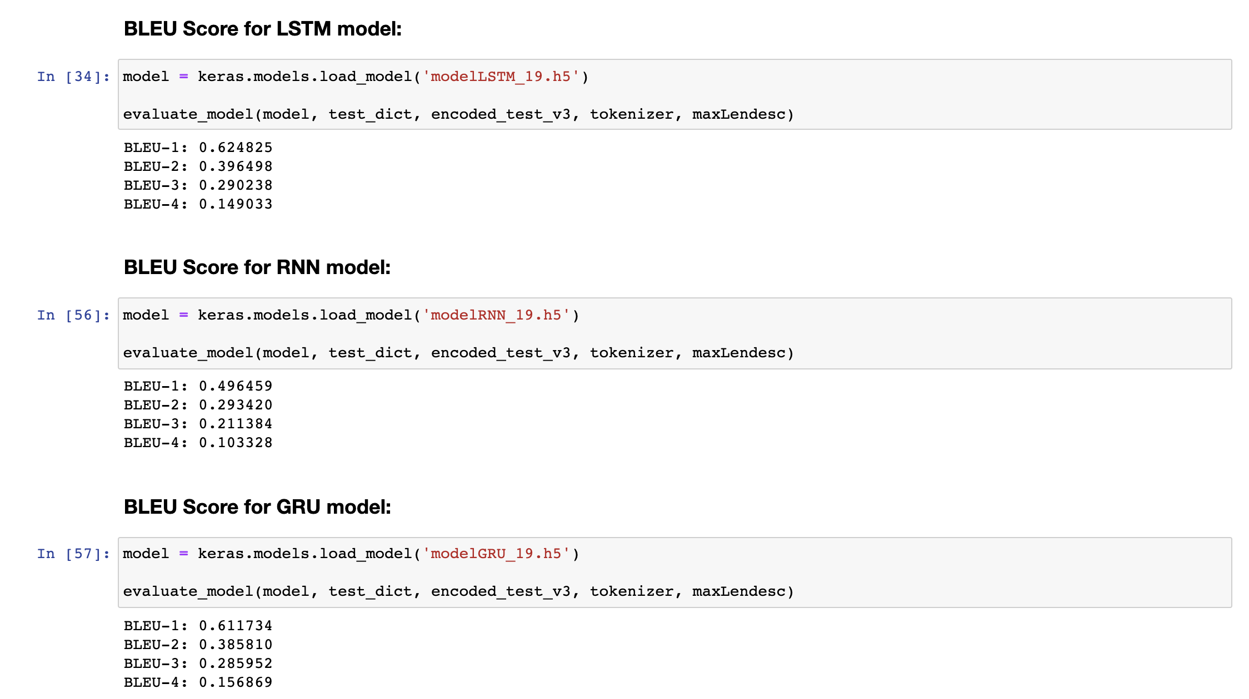
PERFORMANCE EVALUATION
Bilingual Evaluation Understudy Score (BLEU)
BLEU is a metric for evaluating a generated sentence to a reference sentence
BLEU score lies between 0 and 1
LSTM Model performed the best in our case

Slide 11
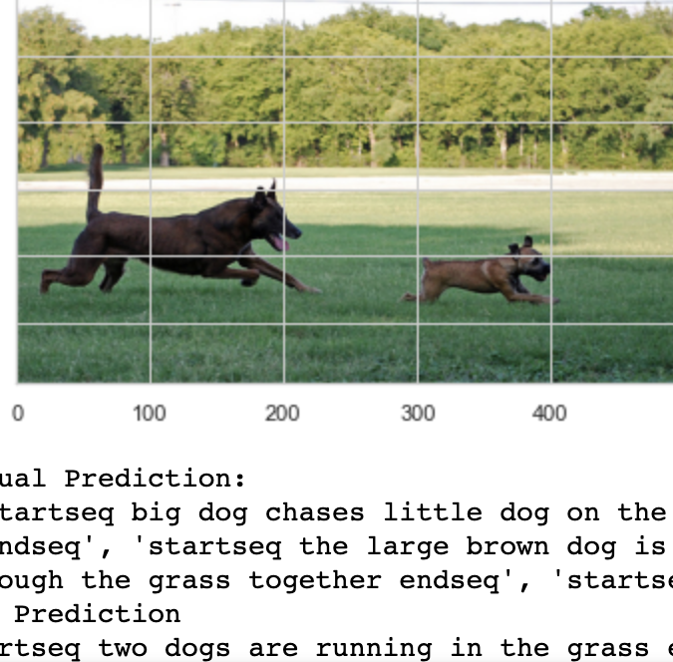
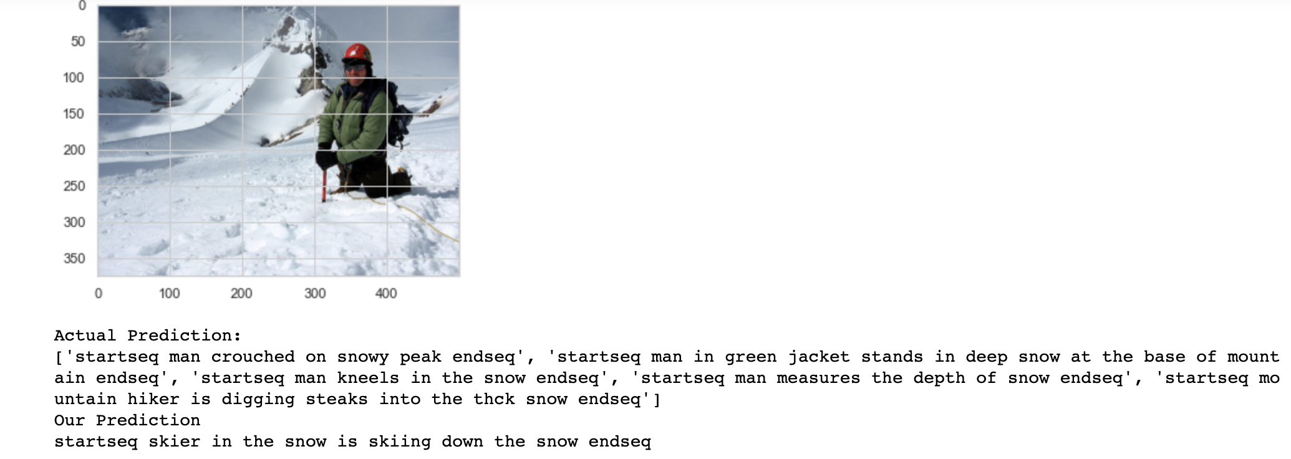
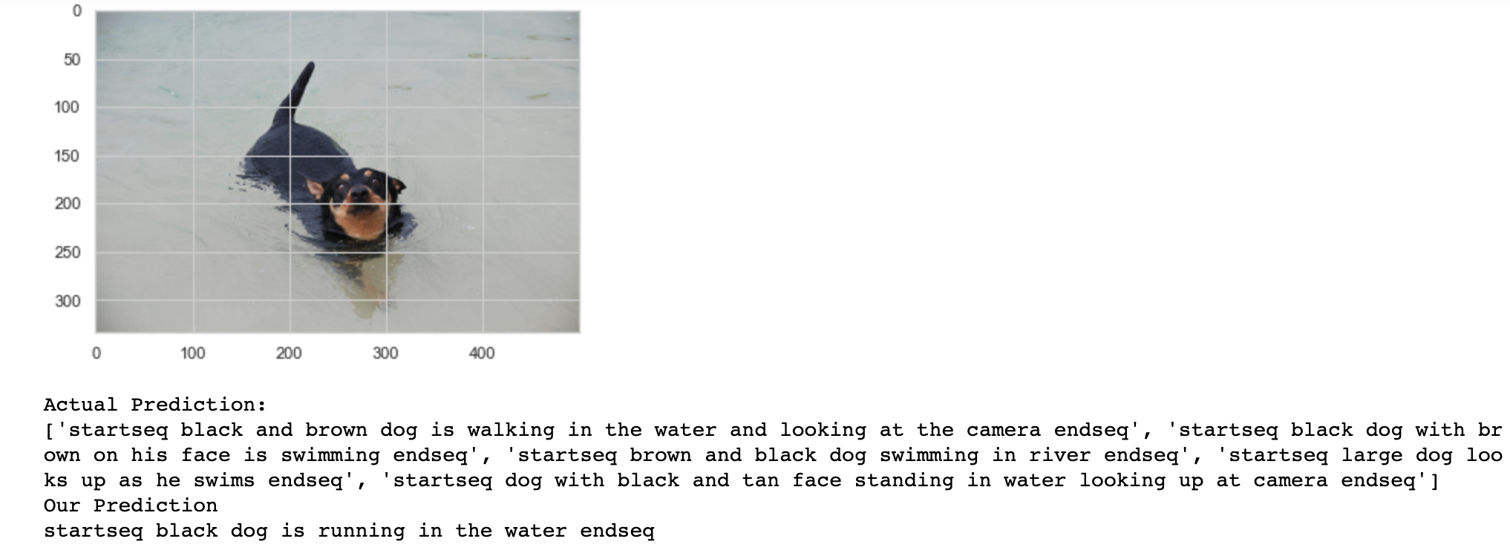

RESULTS(LSTM)

Slide 12
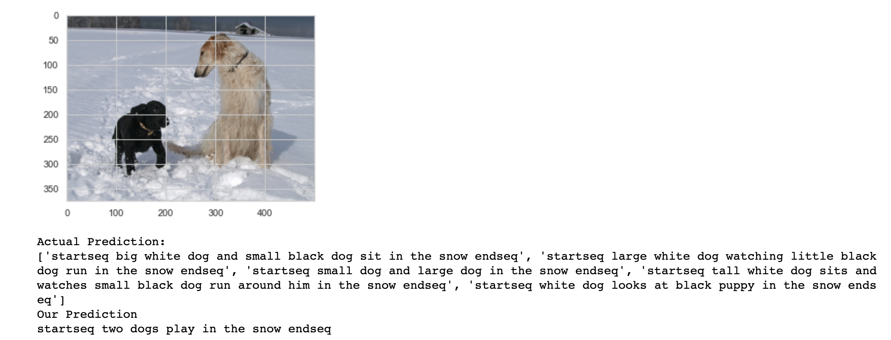
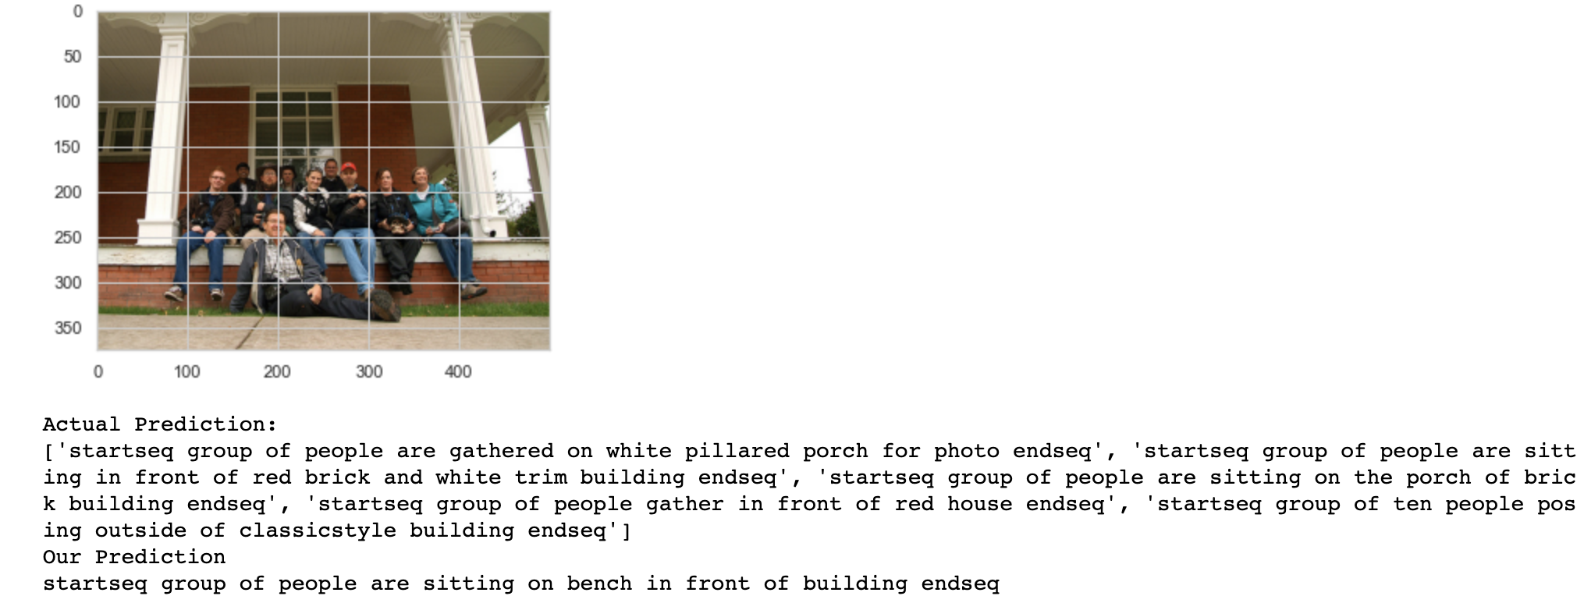
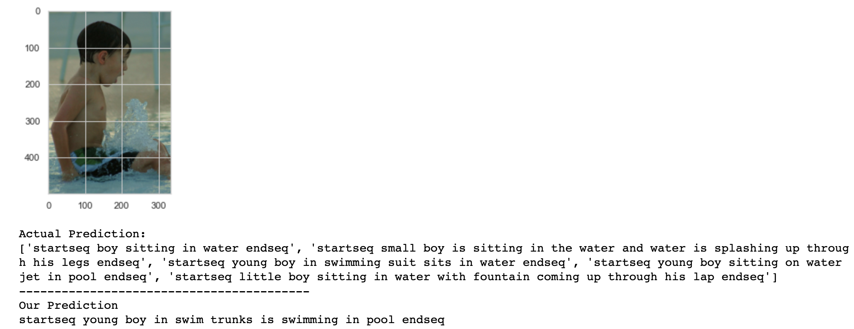
RESULTS(RNN)

Slide 13
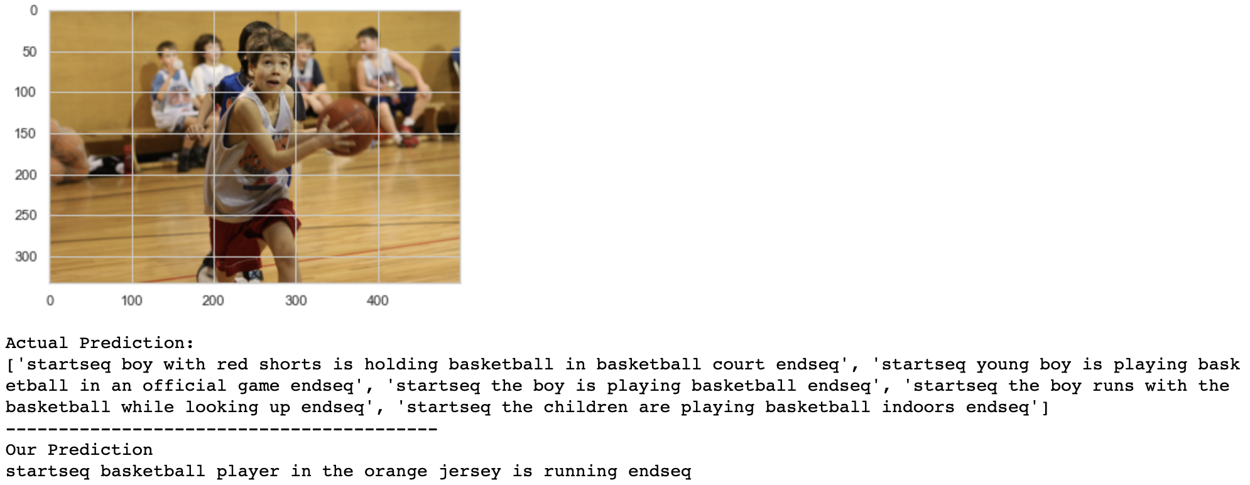
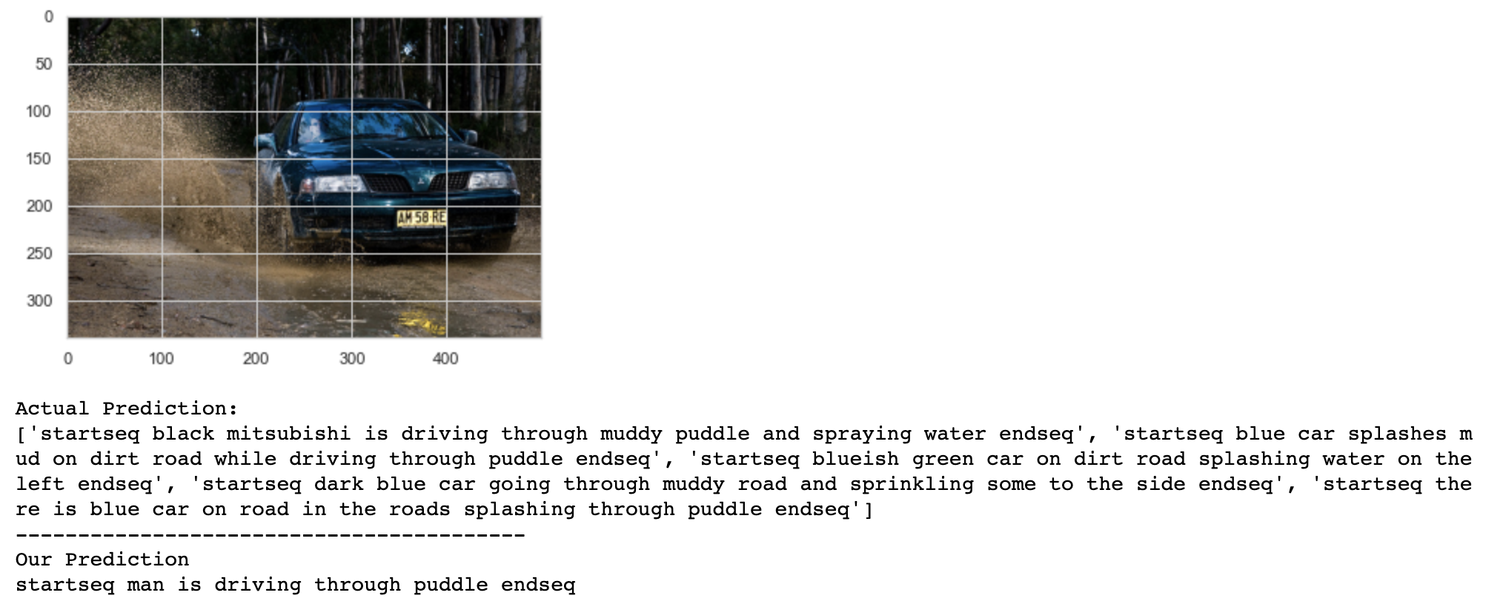
RESULTS(GRU)

Slide 14
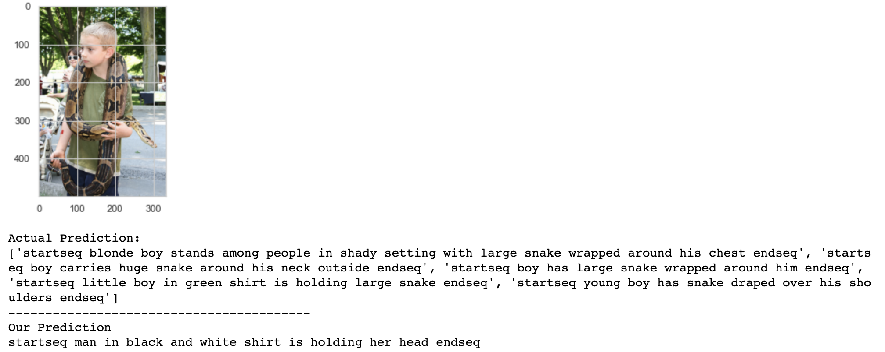
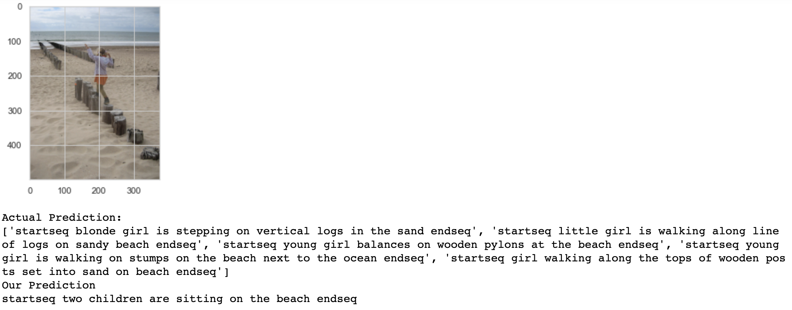
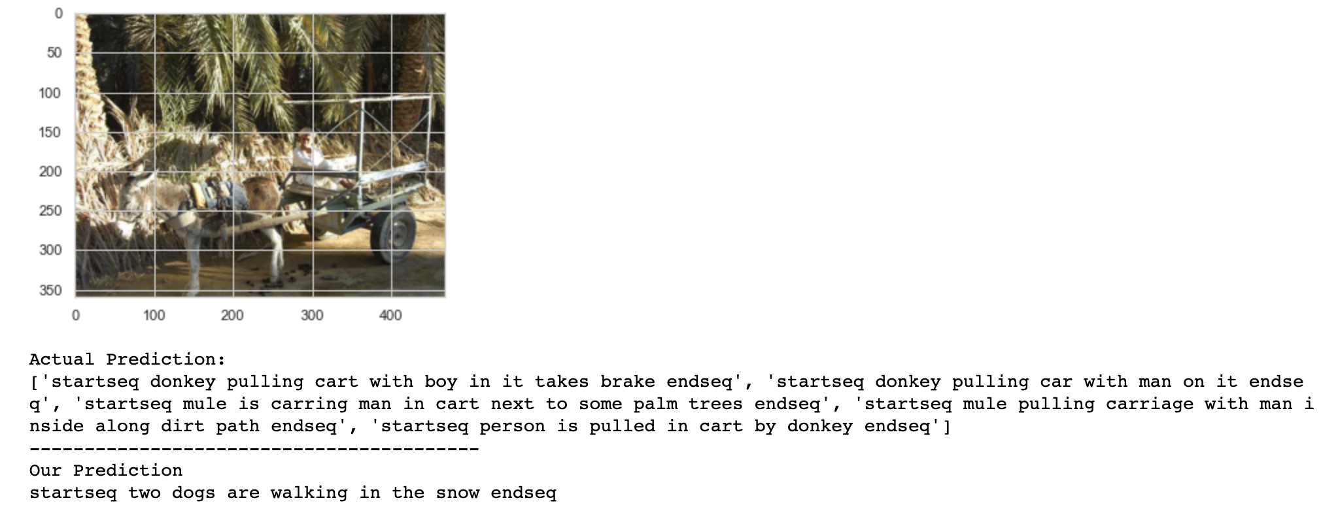
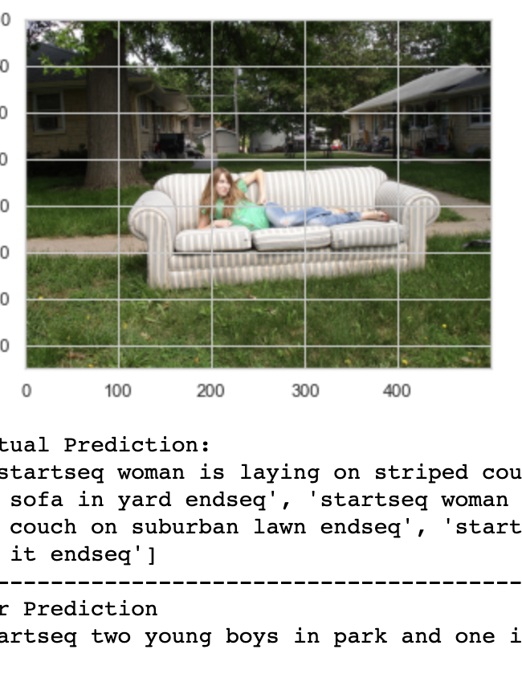
RESULTS(Funny Captions :D)

Slide 15


REFERENCES
https://cs.stanford.edu/people/karpathy/cvpr2015.pdf
https://arxiv.org/abs/1411.4555
https://machinelearningmastery.com/develop-a-deep-learning-caption-generation-model-in-python/
https://thinkautonomous.medium.com/rnns-in-computer-vision-image-captioning-597d5e1321d1
https://machinelearningmastery.com/calculate-bleu-score-for-text-python/

Slide 16
Future WORK
We can enhance the predictions by using more training examples. For example, using Flickr32k dataset which has 32000 images
Creating an application for visually impaired to convert the generated caption into voice output

Slide 17
THANK YOU

